Slide 1

Mapping and Spatial Analysis with ArcGIS and GeoDa
Project Mosaic Workshop
Date Feb 23rd 2017
Paul H. Jung, Behnam Nikparvar
pjung1@uncc.edu, bnikparv@uncc.edu

Slide 2

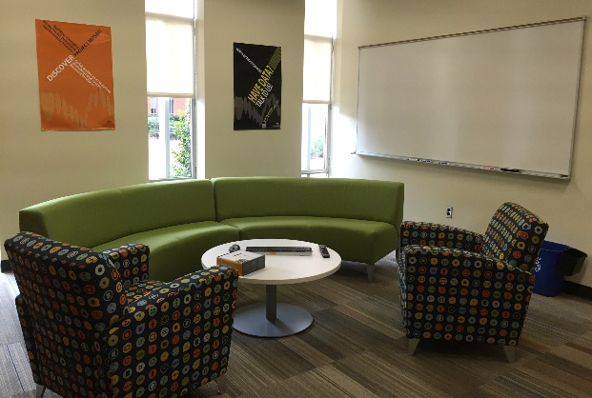
Project Mosaic
Project Mosaic: What do we do?
Build and enhance research analytics capability in social sciences
Facilitate research across social sciences
Coordinate and incubate social science research strategically
Project Mosaic Services
Social sciences research incubator
Facilitate connections
Bring people together to exchange ideas and pursue external funding
Information sharing on research funding opportunities
Consulting
Free to UNC Charlotte faculty, staff and graduate students
Workshops
Open to entire campus community
Provides cutting-edge tools for research and a forum for researchers to network within campus

Slide 3
Mapping and Spatial Analysis
Session I – Mapping and Spatial Analysis with ArcGIS
Introduction to Spatial Analysis
Introduction to ArcGIS
Exercise with Real Data: Segregation in Charlotte
Mapping and Visualization
Session II – Mapping and Spatial Analysis with ArcGIS
Spatial Autocorrelation: Moran’s I Statistics
Hot-Spot Analysis: LISA
Introduction to GeoDa

Slide 4
Introduction to Spatial Analysis

Slide 5
What is Spatial Analysis?
Spatial Analysis
Spatial Analysis includes any of the formal techniques which study entitles using their topological, geometric, or geographic properties.
In other words, Spatial Analysis is a statistical or non-statistical analysis which considers geographical traits of the subjects.
It deals with how the subjects are related with each other in spatial perspective: Spatial Distributional Pattern, Spatial Dependency, Spatial Association, Spatial Regression, Spatial Optimization, Location Analysis

Slide 6
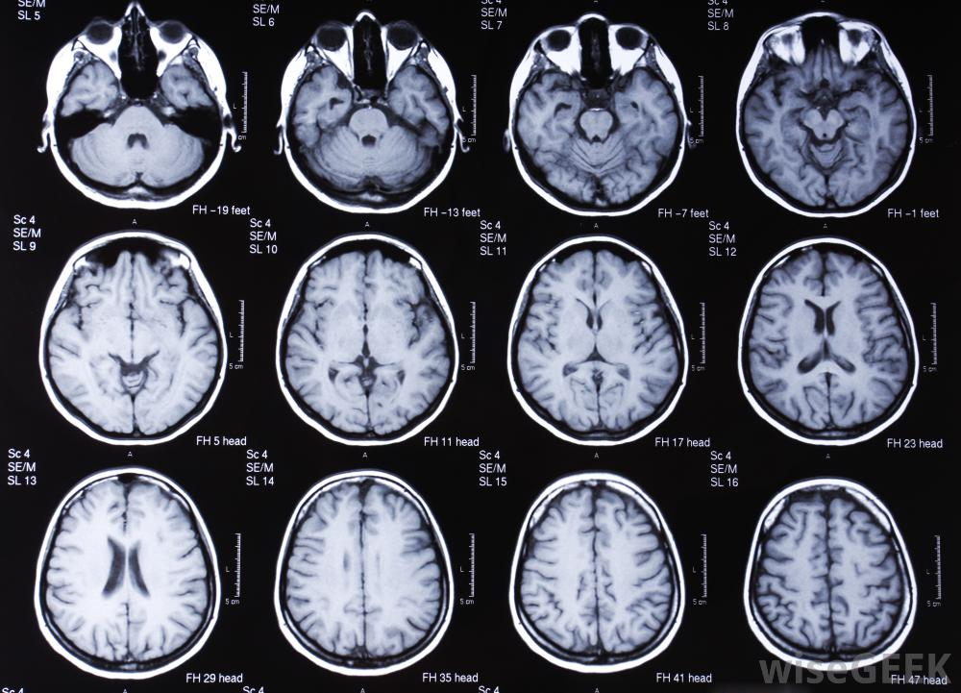
What is Spatial Analysis?
Spatial Analysis
Spatial Analysis functions as radiology at a general hospital.
http://www.wisegeek.org/what-is-a-radiologist.htm#
Notes:
Let me tell you a personal story about this analogy.
In last spring, my father was very sick so he went to the big general hospital at South Korea and stayed at there for a while.
Since one of my friend works there, I called her and asked whatever she can do in regards to my dad.
I had a chance to talk with a lot about Radiology in general hospital, as a geographer, I found she and I have many things in common.
Do you know Radiologists are very powerful in cooperative operation between doctors?
Radiologists do not focus on a specific section of body. But they draw a map of inside of body and diagnose in general and whole view.
With high-tech like X-ray, MRI, CT, they see inside of the body which is not easily revealed to outside. They analyze the pattern of mysterious spots and relate them to other parts of body.
They consult other doctors who focus on specific part like brain, bone, liver and so on.
Surely, spatial analysts are usually specialized in a specific area, but rather they see the pattern of social subjects and how they are related to each other spatially. We can say that spatial analyst take an X-ray picture of specific regions or area. They relate economic feature to social feature or educational features and analyze how they are related.

Slide 7
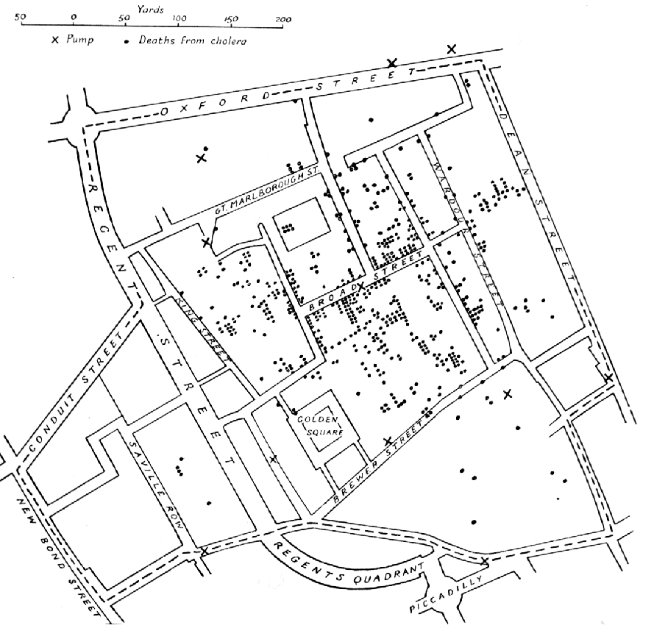
Why Spatial Analysis?
London Cholera Map by John Snow (1854)

Slide 8
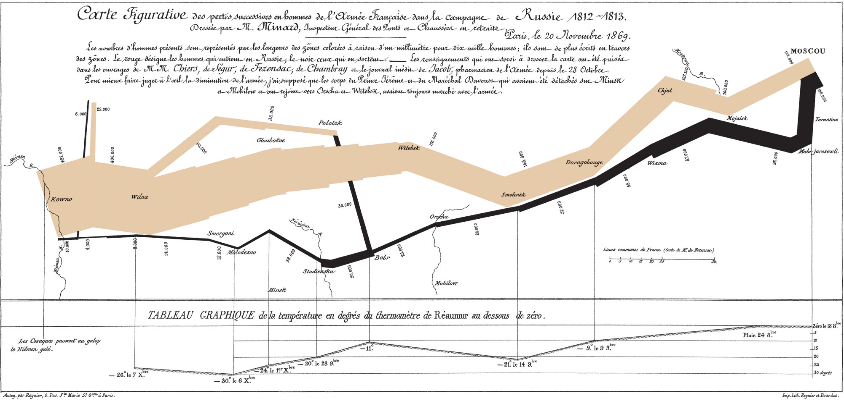
Why Spatial Analysis?
Napoleon’s Russian Campaign by Charles Joseph Minard (1812)

Slide 9
Spatial Analysis with GIS
Geographic Information System (GIS)
A GIS system helps you to store, manipulate, analyze, manage and present all types of spatial and geographical data
People can easily handle and browse spatial data at once and conduct analysis based on their questions

Slide 10
Tasks to do
Task 1: Create a map document, load data, and explore ArcMap
Task 2: Joining table, select by location/attribute
Task 3: Changing data symbology
Task 4: Edit a map layout
Task 5: Explore ArcCatalog

Slide 11
Data
Download data to H drive

Slide 12
Task 1:Explore ArcMap
Start menu > ArcMap
Adding data > Add these layers:
NC_blckgrps.shp
NC_roads.shp
NC_zipcode.shp

Slide 13
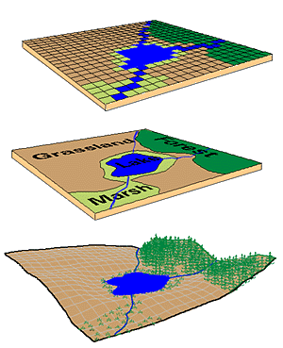
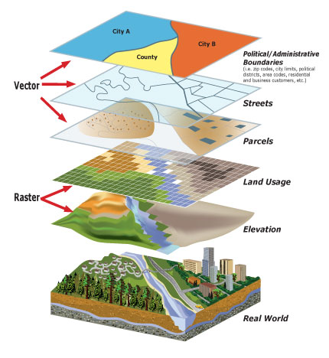
Two fundamental data type
Vector
Raster
Real World
Vector Data vs. Raster Data

Slide 14
Spatial Data
Vector Data
Types of Vector Data
Points - simplest element
Lines (arcs) - set of connected points
Polygons - set of connected lines

Slide 15
Task 1:Explore ArcMap
Turn on/off layers, move them up/down, change symbol
Basemap
Attribute table
Layer properties

Slide 16
Task 2:Query and table join
Add Mcklnbrg.shp
Selection menu > Select by location
Select features within Mcklnbrg.shp
Right click on layer > Data > export

Slide 17
Spatial Data: Data Source
Federal Geographic Data Committee (FGDC)
www.fgdc.gov
Geospatial One-Stop
www.geo-one-stop.gov
U.S. Geological Survey (USGS)
www.usgs.gov
The major provider of GIS data in the US
US Census Bureau
www.census.gov
TIGER Line Files (Streets with addresses, Boundary Units: Counties, zip codes, metro areas, tracts, block groups, blocks)
Notes:
Government Source

Slide 18
Spatial Data: Data Source
The Geography Network (ESRI)
www.geographynetwork.com
Clearinghouse of data from providers around the world.
GIS Data Depot
http://data.geocomm.com
Lots of Free data, some luxury datasets require a small CD Writing fee ($1-$5)
Map-Mart
http://www.mapmart.com
Free and Non-Free data
Tele Atlas
Creates street network and database
Very extensive but expensive
Notes:
Government Source

Slide 19
Popular geographic data formats and software
Shp
KML, KMZ
gdb
GeoJSON, GML
TIFF, GRID, GeoTIFF
ArcGIS (Proprietary)
QGIS (Open source)
GeoDa
SAGA GIS
Grass GIS (Open source)
ILwis
Gvsig

Slide 20
Task 2:Query and table join
Add Census.csv
RC on blockgroup layer > join
Selection > select by attribute
Select blockgroups with median income > 100,000

Slide 21
Task 3:Changing Data Symbology
RC on blockgroups layer > properties > symbology
Quantities
Visualize
1) Black population density
2) White population density
3) Income per capita
4) Median Income
5) Foreclosure rate

Slide 22
Task 4:Map Layout
View > Layout view
Add legend, North arrow, title, and scale bar
To export map > File > export map
Save map document
Relative paths

Slide 23
Task 5:ArcCatalog
Brows to data folder
shp: the feature of geometry itself
shx: a positional index of the feature geometry
dbf: columnar attributes for each shape
ArcCatalog: Windows explorer of GIS data
Only ArcGIS compatible files apear

Slide 24
Next session
Task 1: Types of communities in Charlotte Area
How is each income group distributed in Charlotte area?
Can we detect High/low income region in Charlotte?
How severe is the income segregation problem in Charlotte?
Task 2: Cluster analysis of crash incidents in Washington DC
Is there clusters of crashes in DC?
Can we detect region with high/low crash level?
Introduction to GeoDa

Slide 25
More About Services
Research Incubator
Affiliates Program
Faculty Affiliates are invited for their research expertise in priority research areas
Our affiliates leverage the core functionality and expertise of Project Mosaic
Seed Grants Program
Geared towards the formation of new teams of researchers in the social, behavioral and economic sciences
Aim is to pursue external funding
Consulting
Project Mosaic offers three types of consulting:
Software-centric
Dissertation/thesis assistance
Research deign & collaboration
Workshops
Our workshops fulfill a commitment to enhance data literacy and analytical capabilities of UNC Charlotte researchers
Make an appointment on our website!
Find workshops online on our Events List.

Slide 26



Contact Project Mosaic
Jean-Claude Thill is the director of Project Mosaic. A broadly trained geographer, he is a ‘Knight’ Distinguished Professor of Public Policy at UNC Charlotte.
Contact Jean-Claude:
Email: Jean-Claude.Thill@uncc.edu
Phone: 704-687-5909
Leonora is the Administrative Support for Project Mosaic. She manages our not-so-massive paperwork, coordinates meetings and assists with administrative functions.
Contact Leonora:
Email: projectmosaic@uncc.edu
Phone: 704-687-5931
Visit our website!
Projectmosaic.uncc.edu

Slide 27


Additional Resources: Consultants
Shaoyu Li is the head consultant in the Center of Statistics and Applied Mathematics Consulting Center (CSAMC) and works with Project Mosaic to coordinate consulting requests for data sampling designs and statistical analysis.
Contact Shaoyu:
Email: shaoyu.li@uncc.edu
Kailas Venkitasubramanian is a research methodologist and manages the consulting service and the workshop program of Project Mosaic. Kailas is experienced in a variety of applied statistical techniques and works fluently on multiple software platforms.
Contact Kailas:
Email: kvenkita@uncc.edu
Notes:
https://projectmosaic.uncc.edu/make-a-consulting-appointment/

Slide 28
Questions?

